Slide 1
CS 447/647
Filesystem(s)

Slide 2
Overview
File Attributes
Quotas
Filesystems

Slide 3
File Attributes
The permission bits
setuid and setgid
The sticky bit
Notes:
Login executable

Slide 4
The permissions bits
AKA Portable Operating System Interface (POSIX)
Made up of 9 bits in 3 groups
user (u) 000
group (g) 000
other (o) 000
000000000
001 = 1 Execute
010 = 2 Write
100 = 4 Read
u
g
o
755 = 111 101 101
User - read\write\execute
Group - read\execute
Other - read\execute

Slide 5
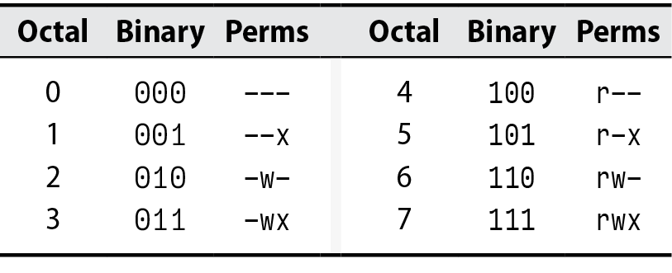

Slide 6
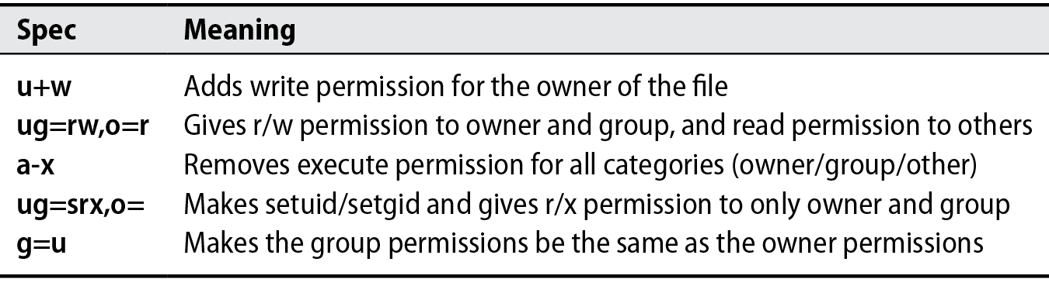

Slide 7
setuid and setgid
setuid
Octal 4000
Run as owner
Used by passwd command to change passwords
Disabled with nosuid mount option
mount -o nosuid /dev/sdc1 /data
setgid
Octal 2000
Runs as group
When set on a directory all files created in the directory inherit the group

Slide 8
The sticky bit
Octal 1000
Historical used as a modifier for binaries
Introduced in 1974 to speed up execution of binaries
Now obsolete
If set on a directory, it only allows deletion of files by
File Owner
Directory Owner
root

Slide 9
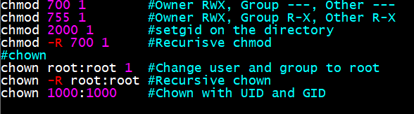
Permissions
chmod - Change file mode bits
chown - Change file owner and group
chgrp - Change file group

Slide 10
Permissions
chmod, chown, chgrp
Use -R sparingly
Clobbers permissions
Better to use find with ch*
find /path -type f -exec chown 644 {} \;
find /path -type d -exec chown 755 {} \;

Slide 11
Permissions - umask
9 bits that represents what permissions to take away upon file creation
Stored in /etc/login.defs and applied via PAM
Unique per process
/proc/$PID/status
ps aux | grep $USER grep umask /proc/$PID/status

Slide 12
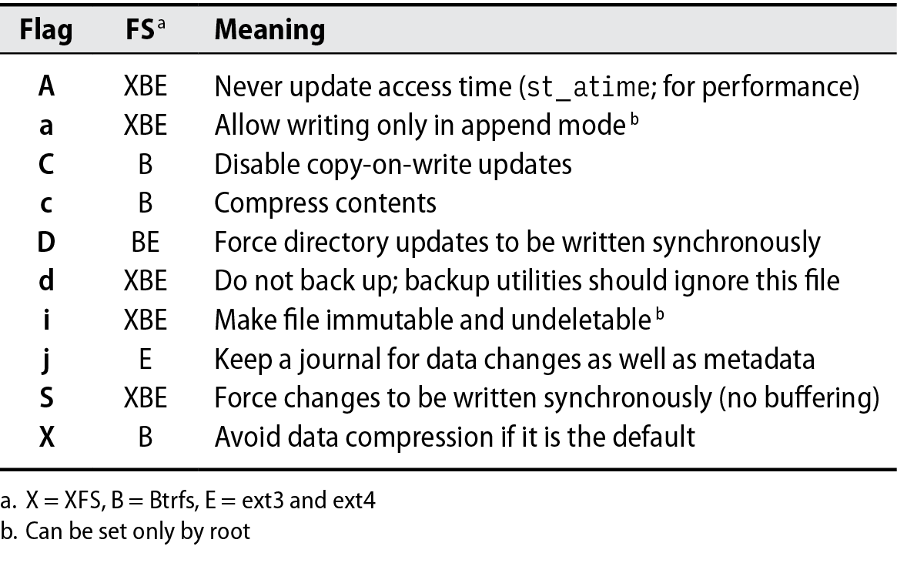
Additional Flags - lattr and chattr

Slide 13
Access Control Lists
Not a niche
Very common on Windows
Any complex environment will need them
NFS
SAMBA*
High-Performance Computing
GPFS, ZFS, etc.
Two types
POSIX
NFSv4

Slide 14
POSIX ACLs
setfacl - set ACL
getfacl - read ACL
apt install -y acl setfacl -m "u:newellz2:rw" file setfacl -m "g:cs447:rx" file setfacl -R -m "u:newellz2:rw" folder setfacl -d -m "u:newellz2:rw" folder #Files inherit this ACL

Slide 15
Windows Permissions
All permissions are ACLs
Graphical
VB
PowerShell
Inheritance
System Accounts\Roles
Authenticated User
Domain Computer
System
Everyone
Guest
Anonymous

Slide 16
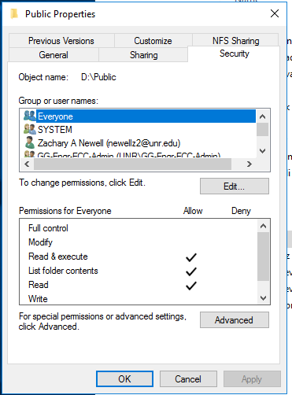

Slide 17
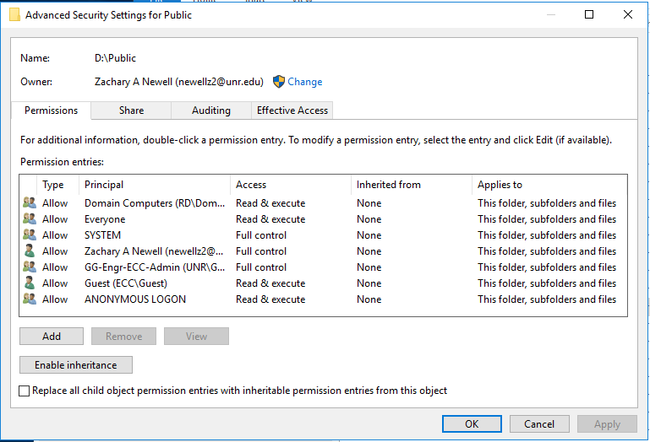

Slide 18
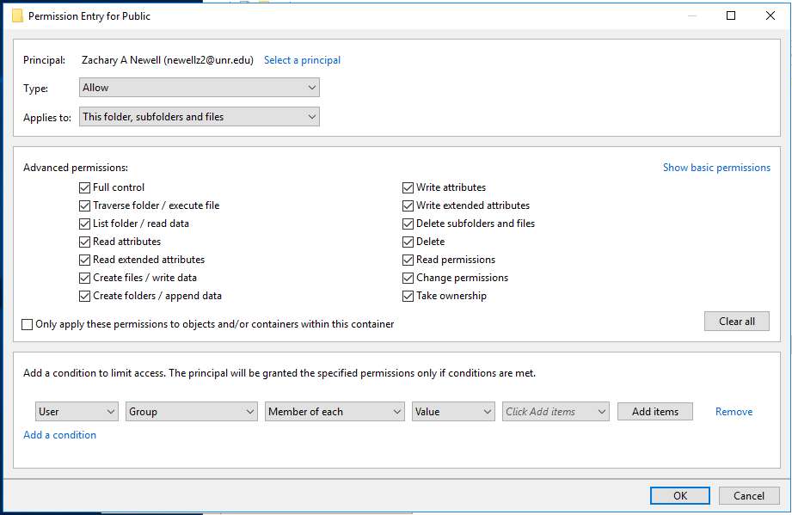

Slide 19
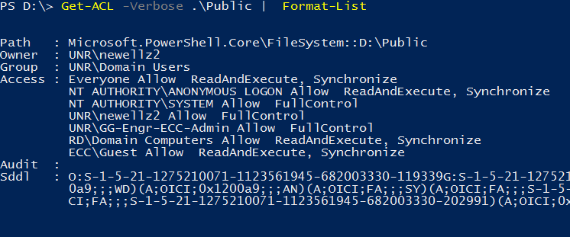
Windows Permissions

Slide 20
ACLs Exercise
Open a root terminal.
Use setfacl -m g:account:rx /data/sales to give the group account read permissions on the /data/sales directory, and use setfacl -m g:sales:rx /data/account to give the group sales read permissions on the /data/account directory.
Use getfacl /data/ to verify that the permissions have been set the way you intended to.
Use setfacl -m d:g:account:rx,g:sales:rwx /data/sales to set the default ACL for the directory sales.
Add the default ACL for the directory /data/account by using setfacl -m d:g:sales:rx,g:account:rwx /data/account.
Verify that the ACL settings are effective by adding a new file in /data/sales. Use touch /data/sales/newfile and use getfacl /data/sales/newfile to check the current permission assignments.

Slide 21
Quotas

Slide 22
xfs
Created in 1993 by Silicon Graphics Inc. (SGI)
A 64-bit journaled filesystem
Suited for large files and filesystems
8 exbibytes max file size
2^64 (1.8446744e+19) max number of files
Supports
Quotas
Snapshots
Live resizing (growing)
Standard FS in SUSE and RedHat

Slide 23
Exercise
mkdir -p /var/tmp/quotas && cd /var/tmp/quotas truncate -s 1G xfs_disk.img #Create a sparse file losetup --find --show xfs_disk.img #Mount the file as a loop dev mkfs.xfs /dev/loop0 #man mkfs.xfs mkfs.xfs -f -L data /dev/loop0 #man mkfs.xfs mount -o defaults,uquota,gquota /dev/loop0 /mnt

Slide 24
Exercise
adduser --disabled-password --gecos "" robert
mkdir /mnt/robert && chown robert /mnt/robert
xfs_quota -x -c 'limit bsoft=75m bhard=100m robert' /mnt
xfs_quota -x -c 'limit isoft=3 ihard=4 robert' /mnt #inode limit dd if=/dev/zero of=/mnt/robert/file.bin bs=1M count=80 chown robert /mnt/robert/file.bin
xfs_quota -x -c 'state'
xfs_quota -x -c 'report'
Notes:
-c command -x expert mode

